Slide 1
What is a Genetic Algorithm ?
Genetic algorithms are randomized search procedures inspired by the mechanics of genetics and natural selection used as derivative free stochastic optimization method .
Genetic algorithms were first proposed and investigated by John Holland at the university of Michigan in 1975.
  To understand the adaptive processes of natural systems
  To design and solve complex problems by simulating the working of natural systems.

Slide 2
What is a Genetic Algorithm? (contd.)
Genetic Algorithms provides efficient, effective techniques for optimization and machine learning applications like pattern recognition, data mining, distributed systems and others.
Genetic algorithm belong to the class of evolutionary algorithm used as an efficient searching technique with features like adaptability, heuristic mechanism.

Slide 3
Feasibility of Genetic Algorithm
Alternative solutions are too slow or overly complicated to implement
Need an exploratory tool to examine new approaches
Problem is similar to one that has already been successfully solved by using a GA in a different domain
Want to hybridize with an other technique for better optimization like neural network, fuzzy logic.
A stopping criteria is available for the problem in which GA is to be used.

Slide 4
Genetic Algorithm for searching
Search Techniques
Calculus Based Techniques
Guided Random Search Techniques
Enumerative Techniques
Direct Methods
Indirect Methods
Evolutionary Algorithms
Simulated Annealing
Dynamic Programming
Fibonacci
Newton
Evolutionary Strategies
Genetic Algorithms
Parallel
Sequential
Centralized
Distributed
Steady-State
Generational

Slide 5
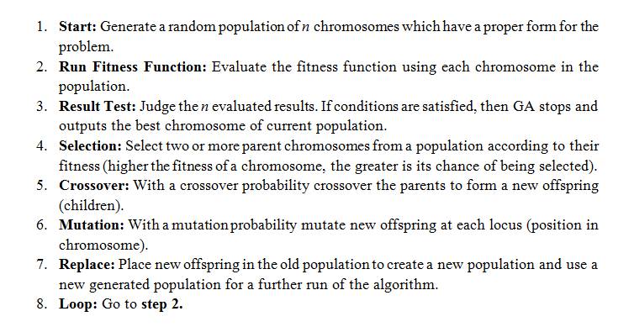
Genetic Algorithm Steps

Slide 6
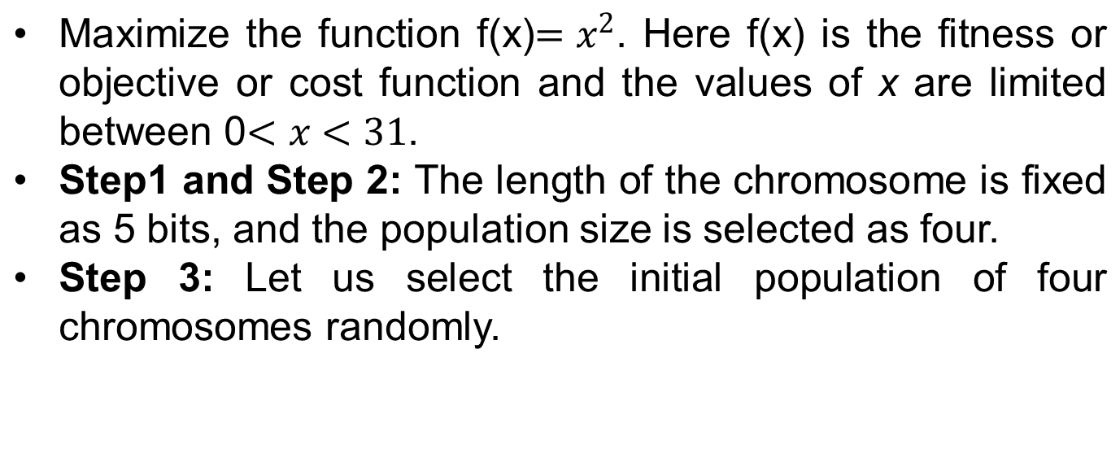
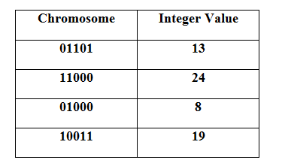
Function maximization using Genetic Algorithm

Slide 7

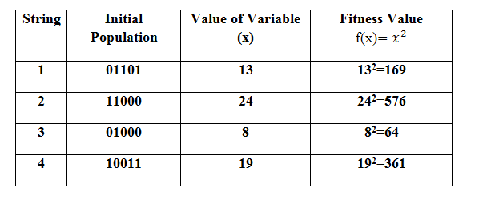
Function maximization using Genetic Algorithm

Slide 8

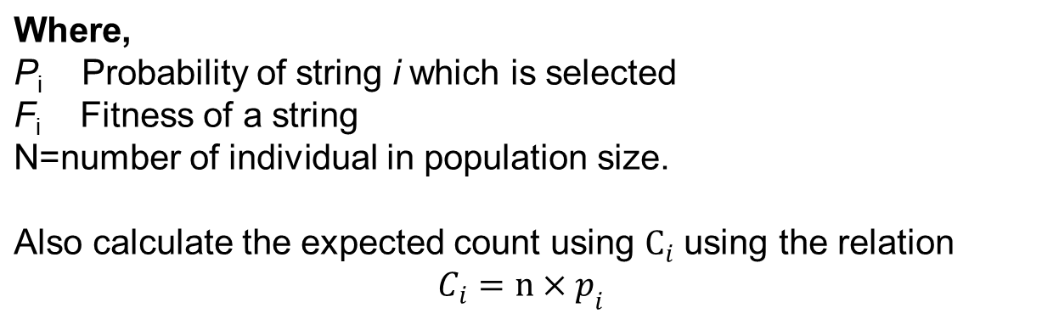
Function maximization using Genetic Algorithm
Step 5: Select parents for the crossover based on their fitness using Roulette wheel selection.

Slide 9
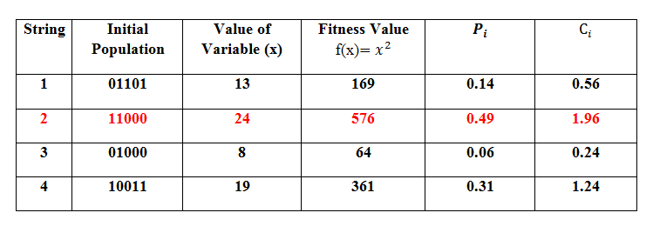
Function maximization using Genetic Algorithm
This table indicates that the string 2 is the best solution.

Slide 10
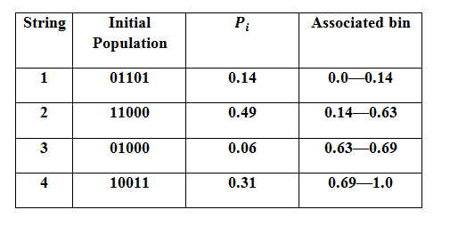
Function maximization using Genetic Algorithm
Step 6: From the probability measure the associated bin is calculated for each individual. This will help while selecting random numbers in the corresponding associated bin of probability to proceed for the next generation.

Slide 11
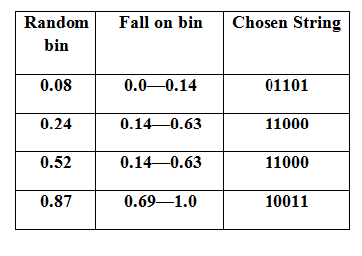
Function maximization using Genetic Algorithm
Let us select the associated bin randomly.
Raw population generated for next generation.

Slide 12
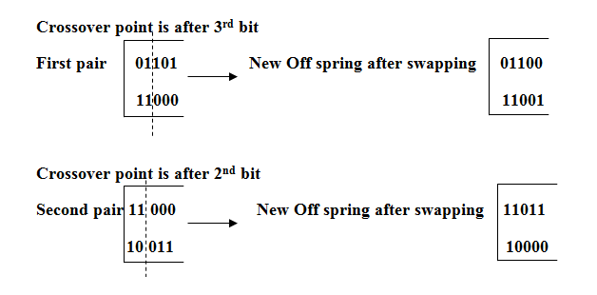
Function maximization using Genetic Algorithm
Mutation between the generated strings

Slide 13
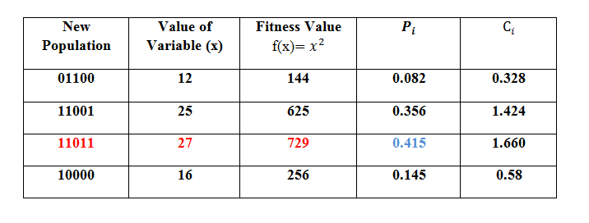
Function maximization using Genetic Algorithm
Optimum solution

Slide 14
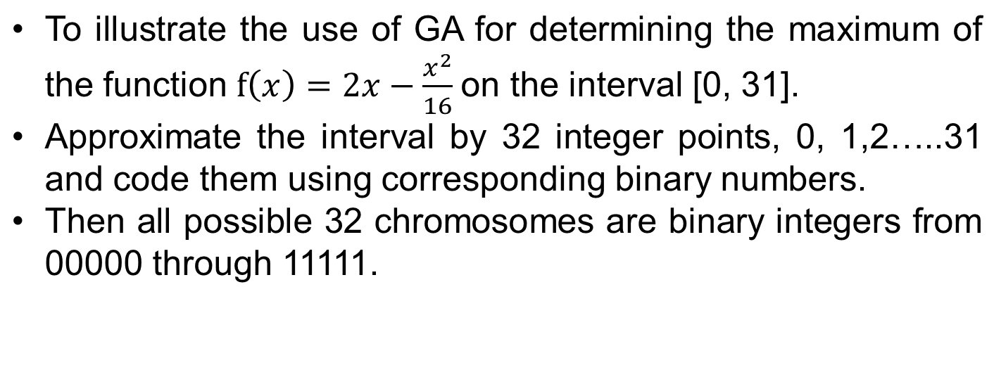
Example 2

Slide 15
Steps in GA for maximization
Step 1: Assuming initial population size as 4 and selecting randomly from the 32 chromosomes we get say the initial population as:
p¹={00010, 01001, 10011,11000}
Step 2: Using the function f as the fitness function calculate the fitness of each chromosome in p¹.
Step 3: Then using deterministic sampling in Step 3 the new population obtained is
p_{a}¹={01001, 10011, 10011,11000}

Slide 16
Steps in GA for maximization
Step 2 and 3
Chromosomes in p¹ | Integers (x) | Fitness f(x) | g(x) | 4. g(x) | Number of selected copies
00010 01001 10011 11000 | 2 9 19 24 | 3.75 12.94 15.44 12.00 | 0.068 0.292 0.350 0.291 | 0.272 1.168 1.400 1.164 | 0 1 2 1

Slide 17
Steps in GA for maximization
Step 4: If given stopping criteria is not met then proceed to step 5.
Chromosomes in p¹ | Mate (randomly selected) | Crossover site (Randomly selected) | Resulting Chromosomes in p²
01001 10011 10011 11000 | 10011 01001 11000 10011 | 3 3 1 1 | 01011 10001 11000 10011

Slide 18
Steps in GA for maximization
Chromosomes in p² | Integers (x) | Fitness f(x) | g(x) | 4. g(x) | Number of selected copies
01011 10001 11000 10011 | 11 17 24 19 | 14.44 15.94 12.00 15.44 | 0.250 0.276 0.207 0.267 | 0.100 1.104 0.828 1.068 | 0 2 1 1
Chromosomes in p² | Mate (randomly selected) | Crossover site (Randomly selected) | Resulting Chromosomes in p²
10001 10001 11000 10011 | 3 (11000) 4 (10011) 1(10001) 2(10001) | 2 3 2 3 | 10000 10011 11001 10001

Slide 19
Steps in GA for maximization
Chromosomes in p³ | Integers (x) | Fitness f(x) | g(x) | 4. g(x) | Number of selected copies
10000 10011 11001 10001 | 16 19 25 17 | 16.00 15.44 10.94 15.94 | 0.274 0.265 0.188 0.273 | 1.096 1.060 0.752 1.092 | 1 1 1 1

Slide 20
Thank You

